Slide 1








Developers Survey by Stack
Fardeen Ahmed Khan
02/04/2024

Slide 2



OUTLINE
Executive Summary
Introduction
Methodology
Results
Visualization – Charts
Dashboard
Discussion
Findings & Implications
Conclusion
Appendix

Slide 3

EXECUTIVE SUMMARY
Data Wrangling and Project Goal
Methodology
Gathering of Data
Data Munging and Analysis
Data Visualization
Graphs and Charts to Support Findings
Discussion Over the Findings and Its Implications
Final Conclusion of the Research

Slide 4

INTRODUCTION
Data Collected by Stack Through Survey of Developers around the Globe
Dataset is Choosed Over Random Sample Set
It Have around 75000 of Responses Across Different Countries
Trends of Developers Current Tools and Possible Future Trends of Tools as well.
Demographic Info of Developers

Slide 5

METHODOLOGY
Web Scaping
APIs
Request Library
Exploratory Data Analysis
Data Distribution
Outliers
Trends

Slide 6
RESULTS

Slide 7

PROGRAMMING LANGUAGE TRENDS
Current Year
Next Year

Slide 8
PROGRAMMING LANGUAGE TRENDS - FINDINGS & IMPLICATIONS
Findings
JavaScript Top on List
Python & SQL not going Anywhere.
Transcript is getting Popular
Implications
Developers Might start using Transcript leaving JavaScript
HTML/CSS and Python Holding their Relevance

Slide 9

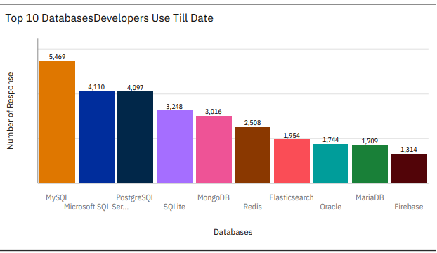
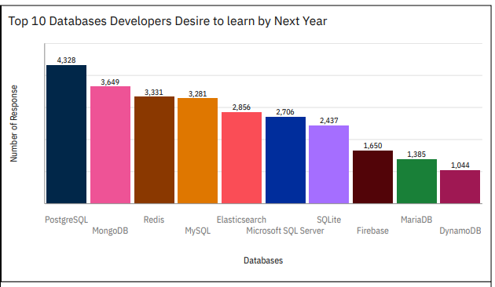
DATABASE TRENDS
Current Year
Next Year

Slide 10
DATABASE TRENDS - FINDINGS & IMPLICATIONS
Findings
MySQL on Top As Usual
MSFT SQL Server and PostgreSQL are Runner-up’s
Implications
PostgreSQL and MongoDB will be Top Databases Next Year.
Developers Losing Interest in MySQL and MSFT SQL Server.

Slide 11

DASHBOARD LINK
<https://github.com/Fardeen6295/Capstone_Project/blob/main/Capstone%20Project.pdf>

Slide 12
DASHBOARD TAB 1
Screenshot of dashboard tab 1 goes here

Slide 13
DASHBOARD TAB 2
Screenshot of dashboard tab 2 goes here

Slide 14
DASHBOARD TAB 3
Screenshot of dashboard tab 3 goes here

Slide 15
DISCUSSION

Slide 16
OVERALL FINDINGS & IMPLICATIONS
Findings
Java Script is Quite Famous but Transcript is Growing Fast.
MySQL is List Topper but Soon PostgreSQL will Take Over.
Linux Platform is Evergreen.
Implications
Men’s Are Dominating the Domain.
Most of the Developers are Just Bachelor’s Degree Holder
Developers Community had Been Globalized from West to East.

Slide 17

CONCLUSION
Developers are Fast Learners and Open to Adaptability.
Many Old Tools are Not Going Anywhere as they Hold their Relevance quite Firmly.
Men are Dominating this Developer’s Community

Slide 18

APPENDIX
Include any relevant additional charts, or tables that you may have created during the analysis phase.

Slide 19
JOB POSTINGS

Slide 20
POPULAR LANGUAGES

